Slide 1
Vehicle Maintenance & Service Management System
BACKEND
Torque Titans

Slide 2


Vehicle Maintenance & Service Management System
01
02
ORACLE SQL DEVELOPER
ERD (ENTITY RELATIONSHIP DIAGRAM)
The backbone technology enabling robust database management
A structured representation of system entities and their relationships.
03
04
STORED PROCEDURE
CLIENT BENEFITS AND BUSINESS IMPACT
Automated processes delivering advanced functionality
Streamlines operations, boosts efficiency, and enhances profitability.

Slide 3
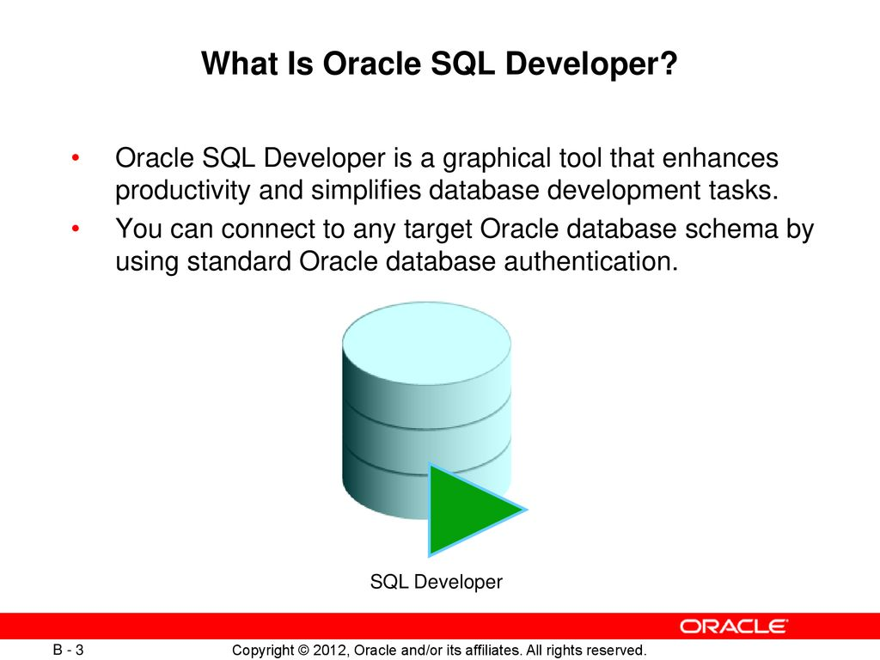
FEATURES
Data Storage: Manages large-scale vehicle and maintenance records.
PL/SQL: Automates processes with stored procedures and triggers.
Query Execution: Retrieves service history and schedules.
Security: Protects sensitive data with access controls.
Integration: Ensures smooth frontend-backend interaction.

Slide 4
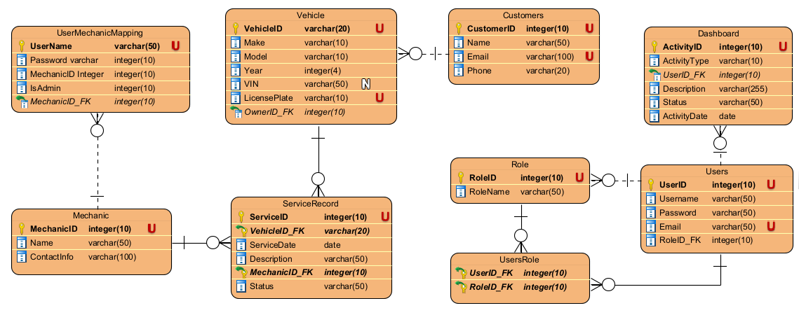
ENTITY RELATIONSHIP DIAGRAM

Slide 5

Stored Procedure : Manage Customer
Purpose
Streamlines customer data management (Create, Read, Update, Delete).
Benefits
Automates repetitive tasks, reducing manual effort.
Ensures data accuracy and consistency in operations.
Enhances system efficiency, improving user experience.

Slide 6

Code : ManageCustomer
CREATE OR REPLACE EDITIONABLE PROCEDURE "MANAGECUSTOMER" (
p_Operation IN VARCHAR2,
p_CustomerID IN NUMBER,
p_Name IN VARCHAR2,
p_Email IN VARCHAR2,
p_Phone IN VARCHAR2
) AS
BEGIN
IF p_Operation = 'CREATE' THEN
INSERT INTO Customers (CustomerID, Name, Email, Phone)
VALUES (Customers_Seq.NEXTVAL, p_Name, p_Email, p_Phone);
ELSIF p_Operation = 'UPDATE' THEN
UPDATE Customers
SET Name = p_Name,
Email = p_Email,
Phone = p_Phone
WHERE CustomerID = p_CustomerID;
ELSIF p_Operation = 'DELETE' THEN
DELETE FROM Customers
WHERE CustomerID = p_CustomerID;
ELSE
RAISE_APPLICATION_ERROR(-20001, 'Invalid operation: ' || p_Operation);
END IF;
COMMIT;
EXCEPTION
WHEN OTHERS THEN
ROLLBACK;
RAISE_APPLICATION_ERROR(-20002, 'Error in ManageCustomer: ' || SQLERRM);
END ManageCustomer;
/

Slide 7

Stored Procedure : Manage Mechanics
Purpose
Manages mechanic information through CRUD actions, ensuring data integrity.
Benefits
Simplifies the administration of mechanic records, enhancing operational flow.

Slide 8
Code : ManageMechanics
REM INSERTING into EXPORT_TABLE
SET DEFINE OFF;
PROCEDURE "MANAGEMECHANICS" (
p_action IN VARCHAR2,
p_MechanicID IN NUMBER DEFAULT NULL,
p_Name IN VARCHAR2 DEFAULT NULL,
p_ContactInfo IN VARCHAR2 DEFAULT NULL,
p_result OUT SYS_REFCURSOR
) AS
v_mechanic_id NUMBER;
BEGIN
IF UPPER(p_action) = 'CREATE' THEN
SELECT mechanic_seq.NEXTVAL INTO v_mechanic_id FROM DUAL;
INSERT INTO Mechanic (MechanicID, Name, ContactInfo)
VALUES (v_mechanic_id, p_Name, p_ContactInfo);
OPEN p_result FOR
SELECT MechanicID, Name, ContactInfo
FROM Mechanic
WHERE MechanicID = v_mechanic_id;
COMMIT;
DBMS_OUTPUT.PUT_LINE('Mechanic created successfully with ID: ' || v_mechanic_id);
ELSIF UPPER(p_action) = 'READ' THEN
OPEN p_result FOR
SELECT MechanicID, Name, ContactInfo
FROM Mechanic
WHERE MechanicID = NVL(p_MechanicID, MechanicID);
ELSIF UPPER(p_action) = 'UPDATE' THEN
UPDATE Mechanic
SET Name = NVL(p_Name, Name),
ContactInfo = NVL(p_ContactInfo, ContactInfo)
WHERE MechanicID = p_MechanicID;
IF SQL%ROWCOUNT > 0 THEN
OPEN p_result FOR
SELECT MechanicID, Name, ContactInfo
FROM Mechanic
WHERE MechanicID = p_MechanicID;
COMMIT;
DBMS_OUTPUT.PUT_LINE('Mechanic updated successfully.');
ELSE
OPEN p_result FOR SELECT * FROM Mechanic WHERE 1=0;
DBMS_OUTPUT.PUT_LINE('No mechanic found with the provided MechanicID.');
END IF;
ELSIF UPPER(p_action) = 'DELETE' THEN
DELETE FROM Mechanic
WHERE MechanicID = p_MechanicID;
IF SQL%ROWCOUNT > 0 THEN
OPEN p_result FOR SELECT * FROM Mechanic WHERE 1=0;
COMMIT;
DBMS_OUTPUT.PUT_LINE('Mechanic deleted successfully.');
ELSE
OPEN p_result FOR SELECT * FROM Mechanic WHERE 1=0;
DBMS_OUTPUT.PUT_LINE('No mechanic found with the provided MechanicID.');
END IF;
ELSE
OPEN p_result FOR SELECT * FROM Mechanic WHERE 1=0;
DBMS_OUTPUT.PUT_LINE('Invalid action. Please use CREATE, READ, UPDATE, or DELETE.');
END IF;
EXCEPTION
WHEN OTHERS THEN
ROLLBACK;
DBMS_OUTPUT.PUT_LINE('Error: ' || SQLERRM);
OPEN p_result FOR SELECT * FROM Mechanic WHERE 1=0;
RAISE;
END;

Slide 9

Stored Procedure : Manage Service Record
Purpose
Oversees service records—vehicle servicing details (Create, Update, Delete)
Benefits
Ensures accurate tracking of services, improving reliability and customer satisfaction.

Slide 10
Code : ManageServiceRecord
PROCEDURE MANAGESERVICERECORD (
p_Operation IN VARCHAR2,
p_ServiceID IN NUMBER,
p_VehicleID IN NUMBER,
p_ServiceDate IN DATE,
p_Description IN VARCHAR2,
p_MechanicID IN NUMBER,
p_Status IN VARCHAR2
) AS
BEGIN
IF p_Operation = 'CREATE' THEN
INSERT INTO ServiceRecord (ServiceID, VehicleID, MechanicID, Description, ServiceDate, Status)
VALUES (ServiceRecord_Seq.NEXTVAL, p_VehicleID, p_MechanicID, p_Description, p_ServiceDate, p_Status);
ELSIF p_Operation = 'UPDATE' THEN
UPDATE ServiceRecord
SET VehicleID = p_VehicleID,
ServiceDate = p_ServiceDate,
Description = p_Description,
MechanicID = p_MechanicID,
Status = p_Status
WHERE ServiceID = p_ServiceID;
ELSIF p_Operation = 'DELETE' THEN
DELETE FROM ServiceRecord
WHERE ServiceID = p_ServiceID;
ELSE
RAISE_APPLICATION_ERROR(-20001, 'Invalid operation: ' || p_Operation);
END IF;
COMMIT;
EXCEPTION
WHEN OTHERS THEN
ROLLBACK;
RAISE_APPLICATION_ERROR(-20002, 'Error in ManageServiceRecord: ' || SQLERRM);
END ManageServiceRecord;

Slide 11

STORED PROCEDURE: Manage Vehicles
Purpose
Facilitates CRUD operations for vehicle data, including ownership details
Benefits
Optimizes vehicle-related management for better efficiency and data accuracy.

Slide 12
Code: ManageVehicles
PROCEDURE MANAGEVEHICLES (
p_action IN VARCHAR2,
p_VehicleID IN NUMBER DEFAULT NULL,
p_Make IN VARCHAR2 DEFAULT NULL,
p_Model IN VARCHAR2 DEFAULT NULL,
p_Year IN NUMBER DEFAULT NULL,
p_LicensePlate IN VARCHAR2 DEFAULT NULL,
p_OwnerID IN NUMBER DEFAULT NULL,
p_result OUT SYS_REFCURSOR
) AS
v_vehicle_id NUMBER;
BEGIN
IF UPPER(p_action) = 'CREATE' THEN
SELECT vehicle_seq.NEXTVAL INTO v_vehicle_id FROM DUAL;
INSERT INTO Vehicle (VehicleID, Make, Model, Year, LicensePlate, OwnerID)
VALUES (v_vehicle_id, p_Make, p_Model, p_Year, p_LicensePlate, p_OwnerID);
OPEN p_result FOR
SELECT VehicleID, Make, Model, Year, LicensePlate, OwnerID
FROM Vehicle
WHERE VehicleID = v_vehicle_id;
COMMIT;
DBMS_OUTPUT.PUT_LINE('Vehicle created successfully with ID: ' || v_vehicle_id);
ELSIF UPPER(p_action) = 'READ' THEN
OPEN p_result FOR
SELECT VehicleID, Make, Model, Year, LicensePlate, OwnerID
FROM Vehicle
WHERE VehicleID = NVL(p_VehicleID, VehicleID);
ELSIF UPPER(p_action) = 'READ_BY_OWNER' THEN
OPEN p_result FOR
SELECT VehicleID, Make, Model, Year, LicensePlate, OwnerID
FROM Vehicle
WHERE OwnerID = p_OwnerID;
ELSIF UPPER(p_action) = 'UPDATE' THEN
UPDATE Vehicle
SET Make = NVL(p_Make, Make),
Model = NVL(p_Model, Model),
Year = NVL(p_Year, Year),
LicensePlate = NVL(p_LicensePlate, LicensePlate),
OwnerID = NVL(p_OwnerID, OwnerID)
WHERE VehicleID = p_VehicleID;
IF SQL%ROWCOUNT > 0 THEN
OPEN p_result FOR
SELECT VehicleID, Make, Model, Year, LicensePlate, OwnerID
FROM Vehicle
WHERE VehicleID = p_VehicleID;
COMMIT;
DBMS_OUTPUT.PUT_LINE('Vehicle updated successfully.');
ELSE
OPEN p_result FOR SELECT * FROM Vehicle WHERE 1=0;
DBMS_OUTPUT.PUT_LINE('No vehicle found with the provided VehicleID.');
END IF;
ELSIF UPPER(p_action) = 'DELETE' THEN
DELETE FROM Vehicle
WHERE VehicleID = p_VehicleID;
IF SQL%ROWCOUNT > 0 THEN
OPEN p_result FOR SELECT * FROM Vehicle WHERE 1=0;
COMMIT;
DBMS_OUTPUT.PUT_LINE('Vehicle deleted successfully.');
ELSE
OPEN p_result FOR SELECT * FROM Vehicle WHERE 1=0;
DBMS_OUTPUT.PUT_LINE('No vehicle found with the provided VehicleID.');
END IF;
ELSE
OPEN p_result FOR SELECT * FROM Vehicle WHERE 1=0;
DBMS_OUTPUT.PUT_LINE('Invalid action. Please use CREATE, READ, READ_BY_OWNER, UPDATE, or DELETE.');
END IF;
EXCEPTION
WHEN OTHERS THEN
ROLLBACK;
DBMS_OUTPUT.PUT_LINE('Error: ' || SQLERRM);
OPEN p_result FOR SELECT * FROM Vehicle WHERE 1=0;
RAISE;
END;

Slide 13
Client Benefits and Business Impact
Centralized Management: Simplifies tracking of customer and vehicle service records.
Automation: Stored procedures (e.g., ManageCustomer) reduce manual effort and errors.
Data Security: Ensures protection of sensitive client and vehicle information.
Operational Efficiency: Enhances productivity with streamlined backend processes
Business Growth: Improves decision-making and client satisfaction, boosting profitability.

Slide 14
THANK YOU
Torque Titans

